Slide 1
Section 4.3
Quadratic Functions
and Their Properties
Copyright © 2012 Pearson Education, Inc. Publishing as Prentice Hall.
Copyright © 2012 Pearson Education, Inc. Publishing as Prentice Hall.

Slide 2



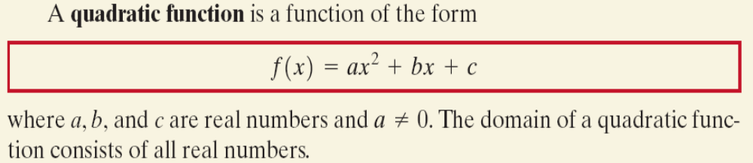
Copyright © 2012 Pearson Education, Inc. Publishing as Prentice Hall.

Slide 3
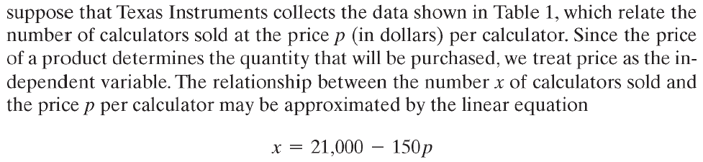
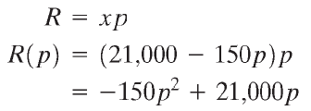
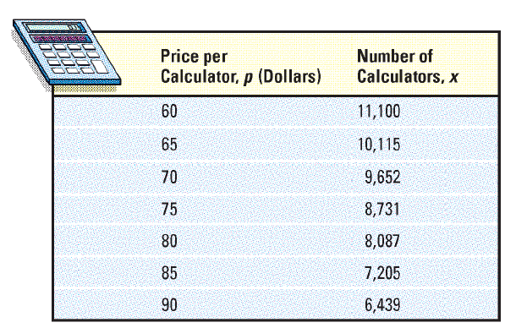
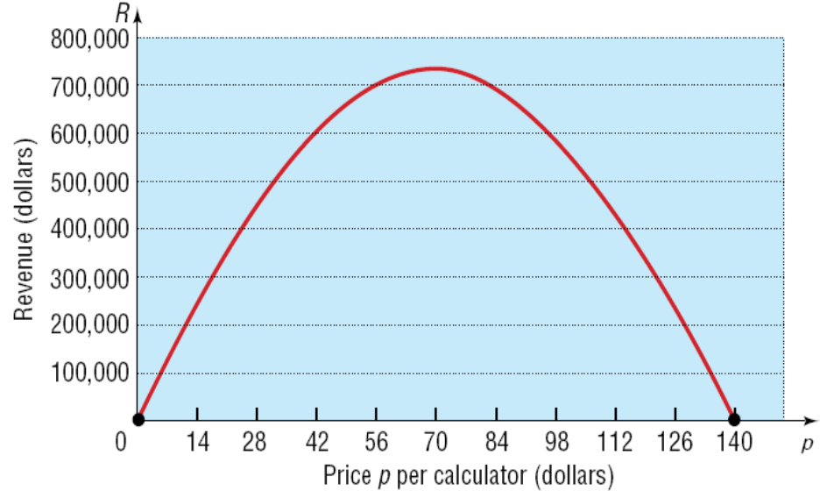

S
Copyright © 2012 Pearson Education, Inc. Publishing as Prentice Hall.

Slide 4
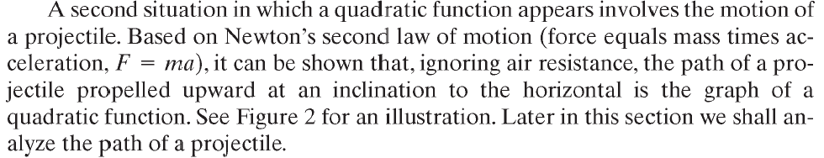
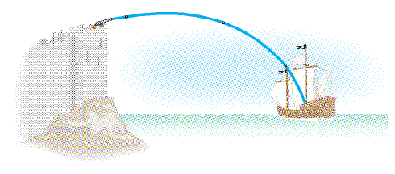

Figure 2
Copyright © 2012 Pearson Education, Inc. Publishing as Prentice Hall.

Slide 5
Copyright © 2012 Pearson Education, Inc. Publishing as Prentice Hall.

Slide 6
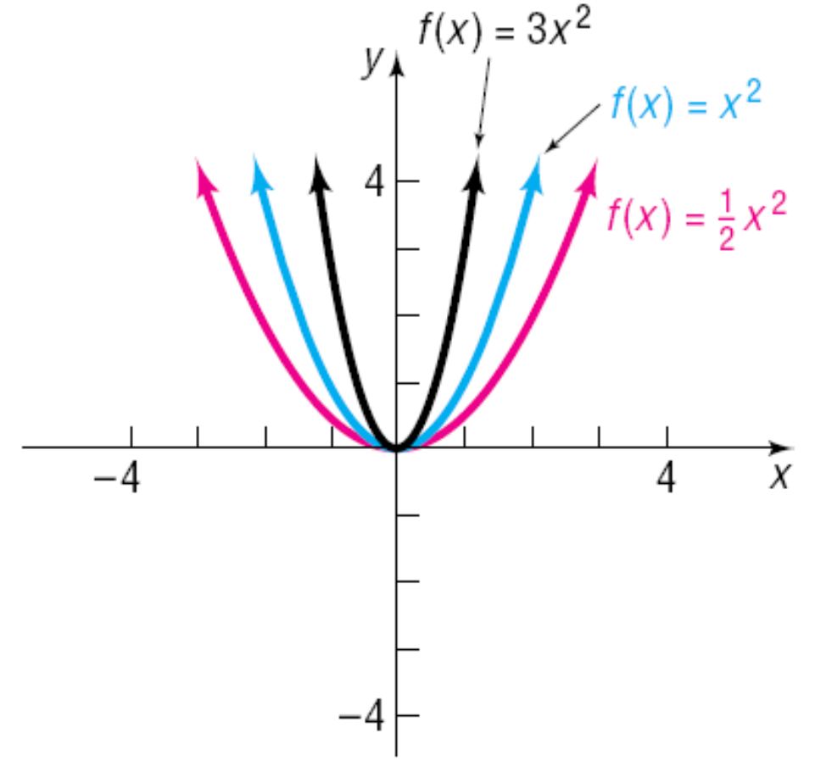

Copyright © 2012 Pearson Education, Inc. Publishing as Prentice Hall.

Slide 7
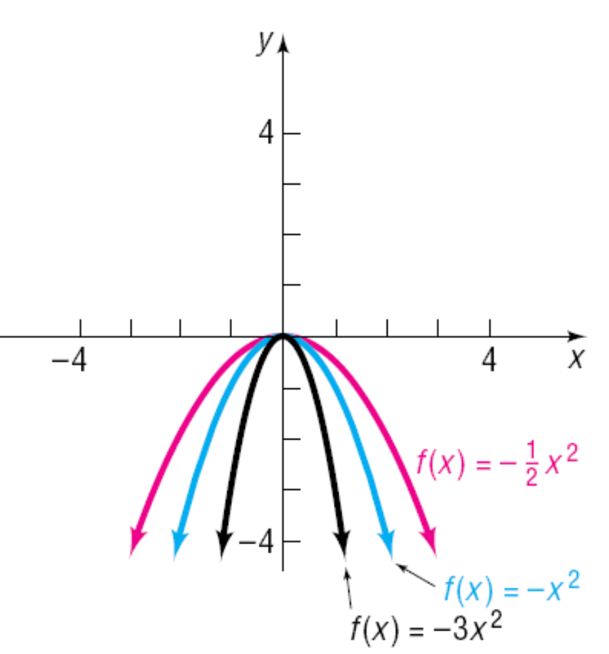

Copyright © 2012 Pearson Education, Inc. Publishing as Prentice Hall.

Slide 8
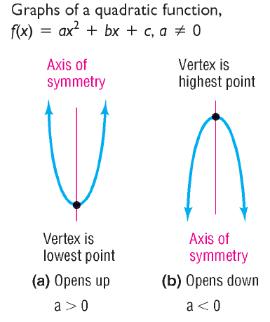
Copyright © 2012 Pearson Education, Inc. Publishing as Prentice Hall.

Slide 9

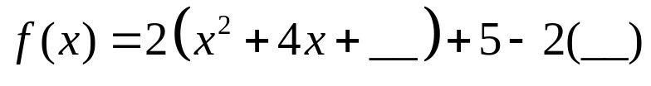
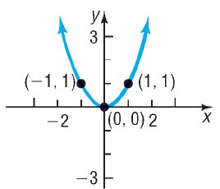

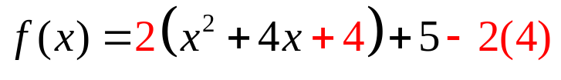
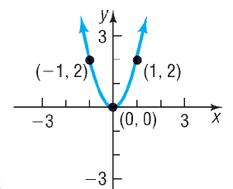
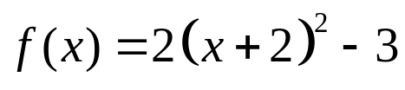


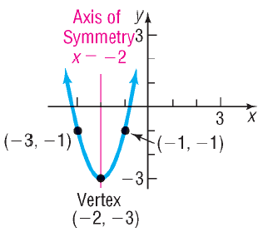

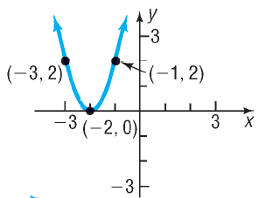
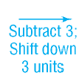



Copyright © 2012 Pearson Education, Inc. Publishing as Prentice Hall.

Slide 10
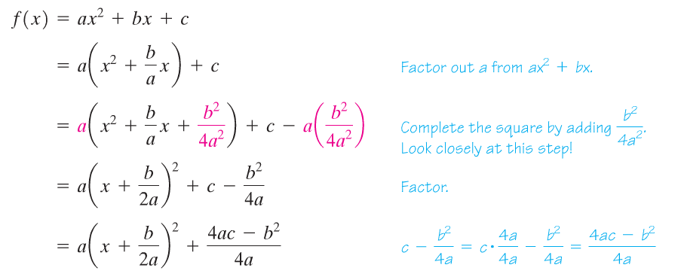
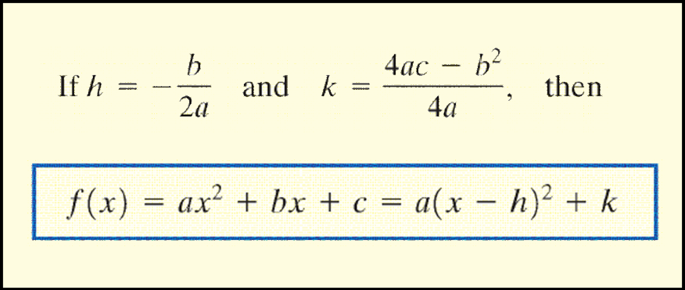
Copyright © 2012 Pearson Education, Inc. Publishing as Prentice Hall.

Slide 11

Copyright © 2012 Pearson Education, Inc. Publishing as Prentice Hall.

Slide 12
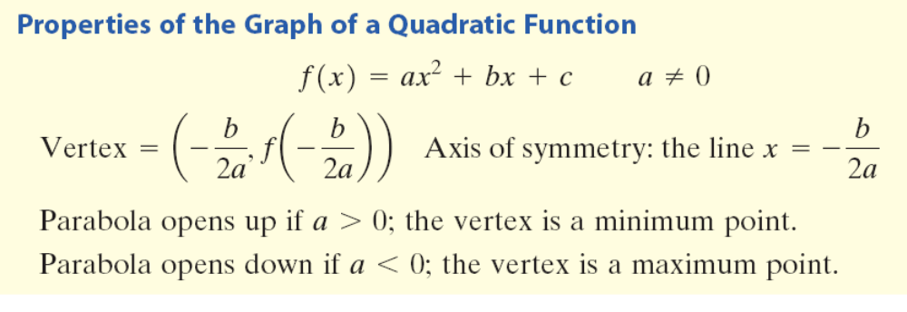
Copyright © 2012 Pearson Education, Inc. Publishing as Prentice Hall.

Slide 13
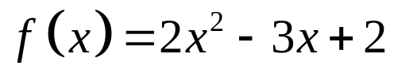
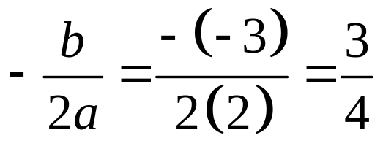

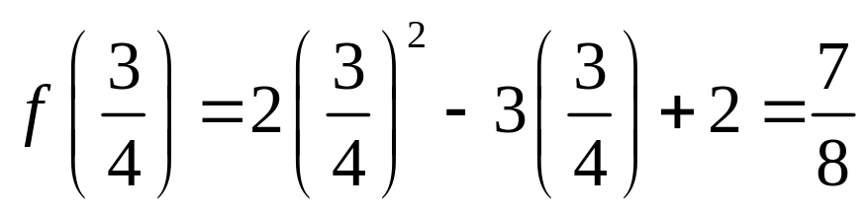
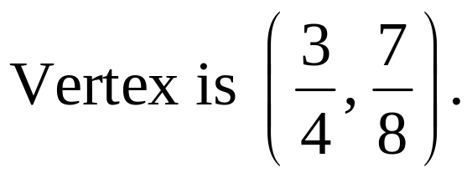
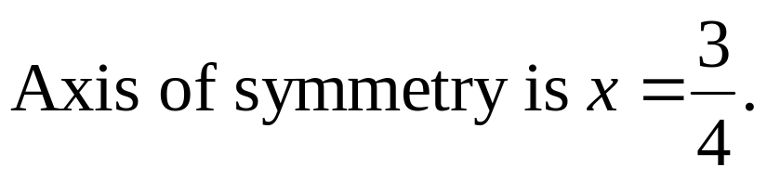
Without graphing, locate the vertex and axis of symmetry of the parabola defined by . Does it open up or down?
Copyright © 2012 Pearson Education, Inc. Publishing as Prentice Hall.

Slide 14

Copyright © 2012 Pearson Education, Inc. Publishing as Prentice Hall.

Slide 15
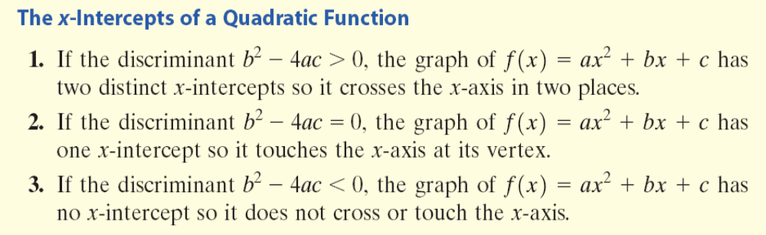
Copyright © 2012 Pearson Education, Inc. Publishing as Prentice Hall.

Slide 16
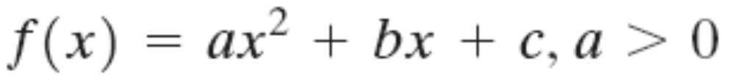
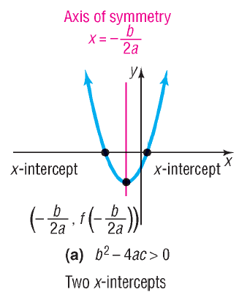
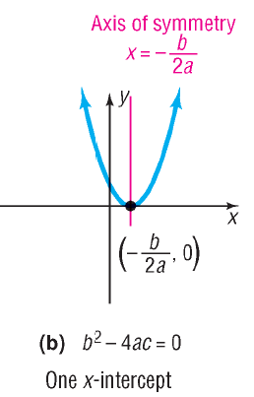
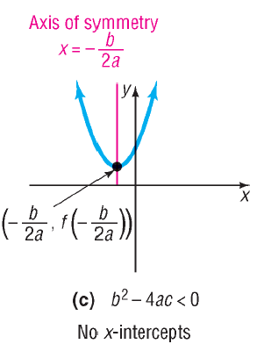
Copyright © 2012 Pearson Education, Inc. Publishing as Prentice Hall.

Slide 17
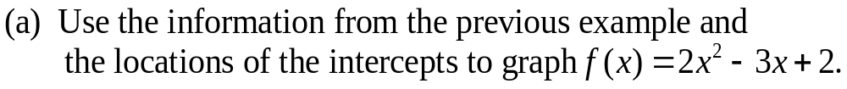
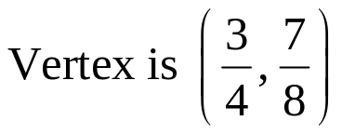
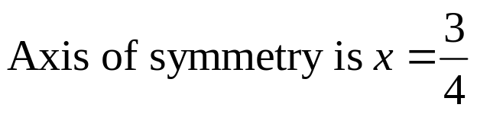
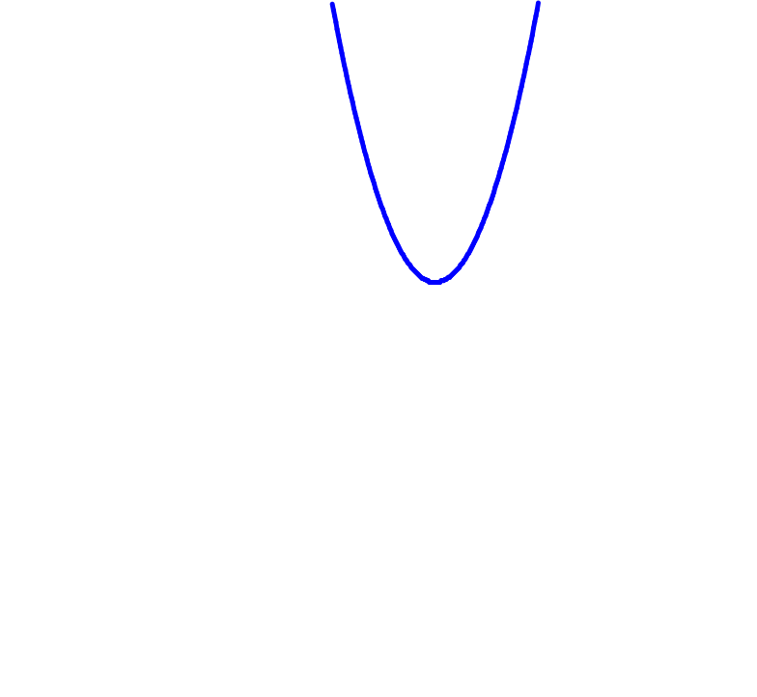
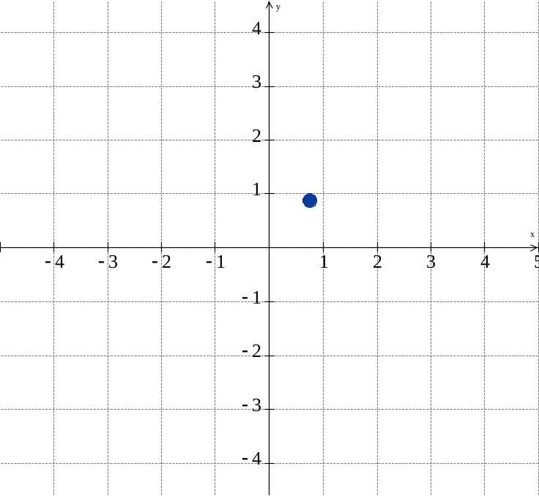

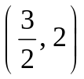
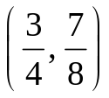
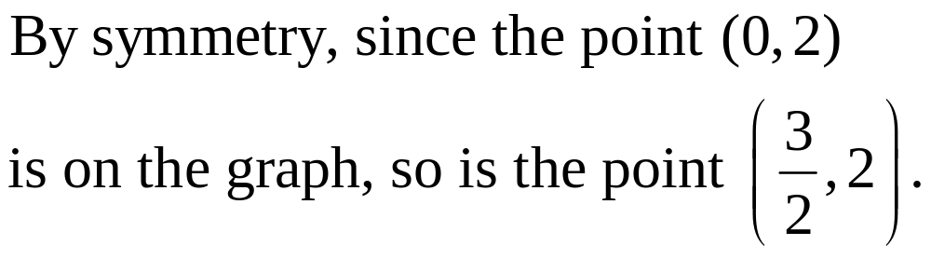
Since a = 2 > 0 the parabola opens up and therefore will have no x-intercepts.

Slide 18
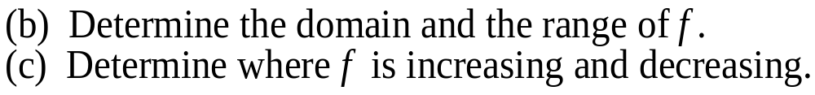
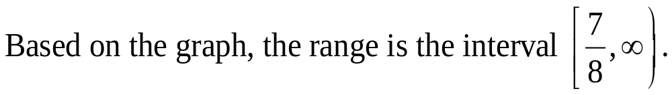
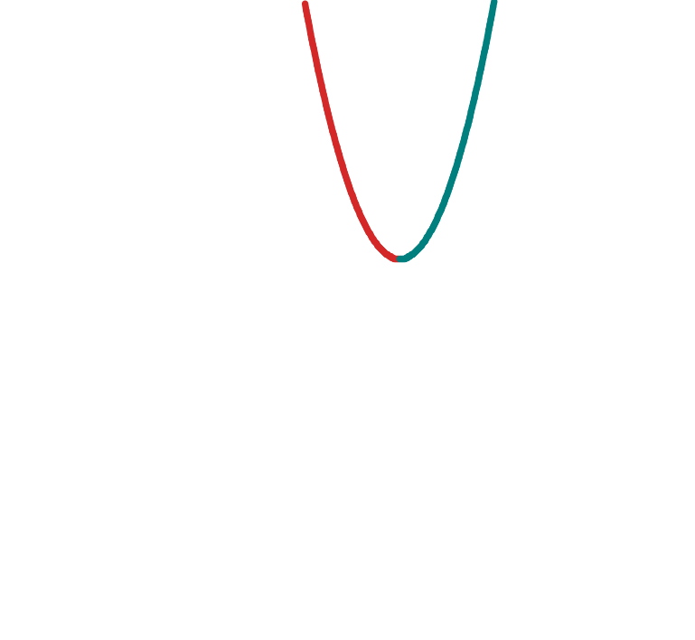
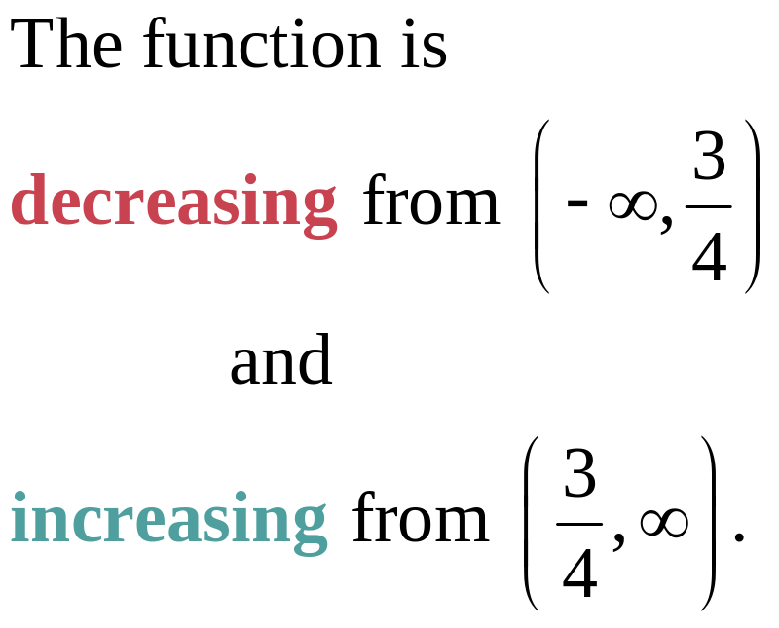
The domain of f is the set of all real numbers.

Slide 19
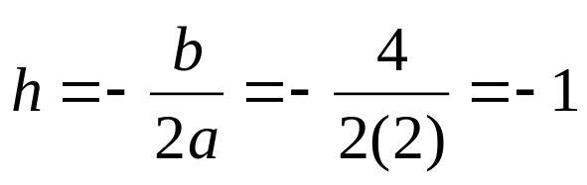
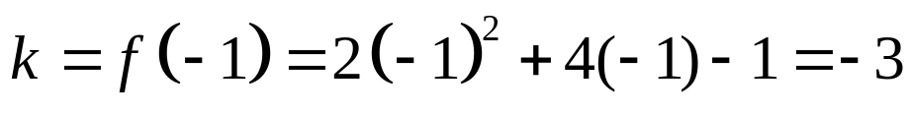

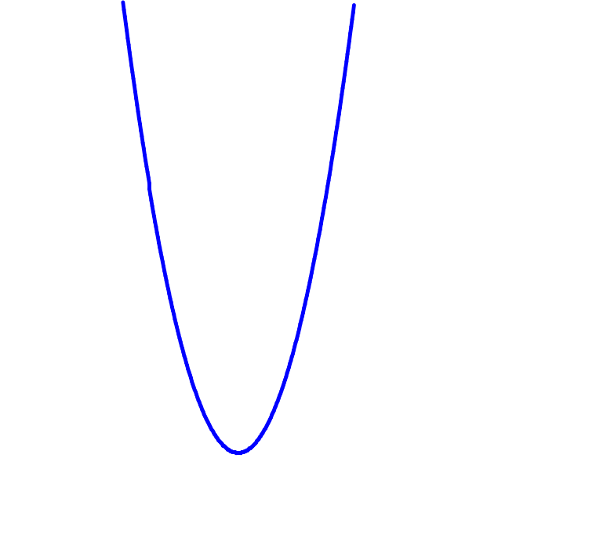
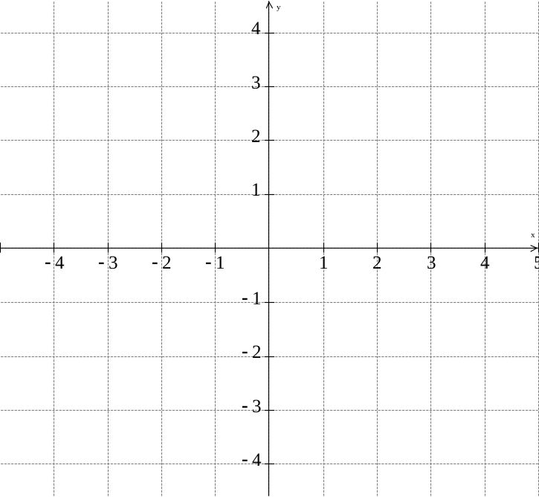
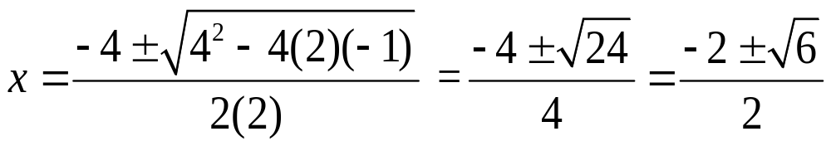





Since a = 2 > 0 the parabola opens up.

Slide 20
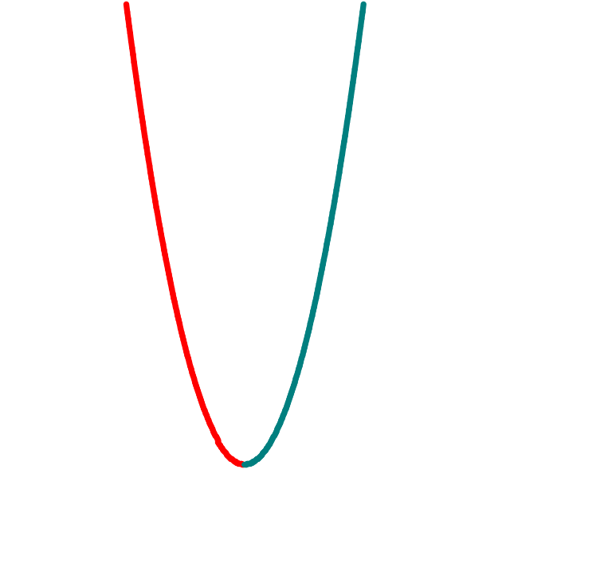
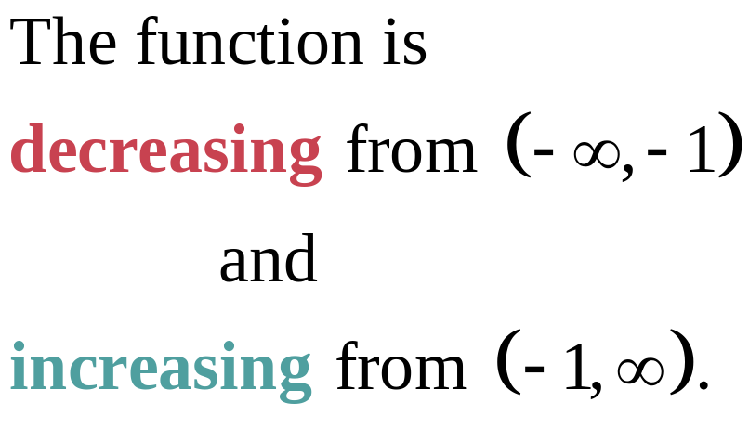
The domain of f is the set of all real numbers.

Slide 21










Since a is negative, the parabola opens down.

Slide 22


The domain of f is the set of all real numbers.

Slide 23
Copyright © 2012 Pearson Education, Inc. Publishing as Prentice Hall.

Slide 24

Copyright © 2012 Pearson Education, Inc. Publishing as Prentice Hall.

Slide 25






Determine the quadratic function whose vertex is (–2, 3) and whose y-intercept is 1.
Copyright © 2012 Pearson Education, Inc. Publishing as Prentice Hall.

Slide 26
Copyright © 2012 Pearson Education, Inc. Publishing as Prentice Hall.

Slide 27


Since a is negative, the graph of f opens down so the function will have a maximum value.
Copyright © 2012 Pearson Education, Inc. Publishing as Prentice Hall.

Slide 28

Copyright © 2012 Pearson Education, Inc. Publishing as Prentice Hall.

